Slide 1
Attitudes of Ukrainians towards countries of the world
Results of public opinion research, April 2025

Slide 2
Methodology
Method of collecting information: online self-completion of questionnaires in the "SunFlowerSociology" panel
General population: citizens of Ukraine aged 18 and older
The sample is representative in terms of age, gender and region of Ukraine
Number of completed questionnaires: 800
Data collection period: April 2025
Theoretical statistical error of representativeness (at a confidence level of 95% and):
response rate of 50% - +/-3.5%
response rates of 25% and 75% - +/- 3.0%
the response rate of 10% and 90% is +/- 2.1%.

Slide 3
Attitude towards the United States
The exact wording of the question:
"What is your attitude toward the United States: more positive or negative?"

Slide 4
Attitudes towards Canada
The exact wording of the question:
"What is your attitude towards Canada: more positive or negative?"

Slide 5
Attitudes towards Mexico
The exact wording of the question:
"What is your attitude towards Mexico: more positive or negative?"

Slide 6
Attitude towards France
The exact wording of the question:
"What is your attitude towards France: more positive or negative?"

Slide 7
Attitudes towards the UK
The exact wording of the question:
"What is your attitude towards the UK: more positive or negative?"

Slide 8
Attitude towards Italy
The exact wording of the question:
"What is your attitude towards Italy: more positive or negative?"

Slide 9
Attitudes towards Spain
The exact wording of the question:
"What is your attitude towards Spain: more positive or negative?"

Slide 10
Attitudes towards Germany
The exact wording of the question:
"What is your attitude towards Germany: more positive or negative?"

Slide 11
Attitudes towards the Netherlands
The exact wording of the question:
"What is your attitude towards the Netherlands: more positive or negative?"

Slide 12
Attitudes towards Sweden
The exact wording of the question:
"What is your attitude towards Sweden: more positive or negative?"

Slide 13
Attitude towards Denmark
The exact wording of the question:
"What is your attitude towards Denmark: more positive or negative?"

Slide 14
Attitudes towards Poland
The exact wording of the question:
"What is your attitude towards Poland: more positive or negative?"

Slide 15
Attitudes towards Hungary
The exact wording of the question:
"What is your attitude towards Hungary: more positive or negative?"

Slide 16
Attitudes towards Slovakia
The exact wording of the question:
"What is your attitude towards Slovakia: more positive or negative?"

Slide 17
Attitudes towards the Czech Republic
The exact wording of the question:
"What is your attitude towards the Czech Republic: More positive or negative?"

Slide 18
Attitudes towards Romania
The exact wording of the question:
"What is your attitude towards Romania: more positive or negative?"

Slide 19
Attitudes towards Bulgaria
The exact wording of the question:
"What is your attitude towards Bulgaria: more positive or negative?"

Slide 20
Attitudes towards Serbia
The exact wording of the question:
"What is your attitude towards Serbia: more positive or negative?"

Slide 21
Attitude towards Algeria
The exact wording of the question:
"What is your attitude towards Algeria: more positive or negative?"

Slide 22
Attitudes toward Egypt
The exact wording of the question:
"What is your attitude towards Egypt: more positive or negative?"

Slide 23
Attitudes toward Iraq
The exact wording of the question:
"What is your attitude towards Iraq: more positive or negative?"

Slide 24
Attitude towards Jordan
The exact wording of the question:
"What is your attitude towards Jordan: more positive or negative?"

Slide 25
Attitude towards Kuwait
The exact wording of the question:
"What is your attitude towards Kuwait: more positive or negative?"

Slide 26
Attitude towards Lebanon
The exact wording of the question:
"What is your attitude towards Lebanon: more positive or negative?"

Slide 27
Attitudes towards Turkey
The exact wording of the question:
"What is your attitude towards Turkey: more positive or negative?"

Slide 28
Attitudes toward Iran
The exact wording of the question:
"What is your attitude towards Iran: more positive or negative?"

Slide 29
Attitude towards Palestine
The exact wording of the question:
"What is your attitude towards Palestine: more positive or negative?"

Slide 30
Attitudes towards Israel
The exact wording of the question:
"What is your attitude toward Israel: more positive or negative?"

Slide 31
Attitude towards Qatar
The exact wording of the question:
"What is your attitude towards Qatar: more positive or negative?"

Slide 32
Attitudes towards Saudi Arabia
The exact wording of the question:
"What is your attitude towards Saudi Arabia: more positive or negative?"

Slide 33
Attitude towards Syria
The exact wording of the question:
"What is your attitude towards Syria: more positive or negative?"

Slide 34
Attitudes towards Tunisia
The exact wording of the question:
"What is your attitude towards Tunisia: more positive or negative?"

Slide 35
Attitude to the United Arab Emirates
The exact wording of the question:
"What is your attitude towards the United Arab Emirates: more positive or negative?"

Slide 36
Attitude towards Yemen
The exact wording of the question:
"What is your attitude towards Yemen: more positive or negative?"

Slide 37
Attitudes towards Kazakhstan
The exact wording of the question:
"What is your attitude towards Kazakhstan: more positive or negative?"

Slide 38
Attitudes towards Kyrgyzstan
The exact wording of the question:
"What is your attitude towards Kyrgyzstan: more positive or negative?"

Slide 39
Attitudes towards Tajikistan
The exact wording of the question:
"What is your attitude towards Tajikistan: more positive or negative?"

Slide 40
Attitudes towards Turkmenistan
The exact wording of the question:
"What is your attitude towards Turkmenistan: more positive or negative?"

Slide 41
Attitudes towards Uzbekistan
The exact wording of the question:
"What is your attitude towards Uzbekistan: more positive or negative?"

Slide 42
Attitudes towards Azerbaijan
The exact wording of the question:
"What is your attitude towards Azerbaijan: more positive or negative?"

Slide 43
Attitudes towards Armenia
The exact wording of the question:
"What is your attitude towards Armenia: more positive or negative?"

Slide 44
Attitudes towards Georgia
The exact wording of the question:
"What is your attitude towards Georgia: more positive or negative?"

Slide 45
Attitudes towards China
The exact wording of the question:
"What is your attitude towards China: more positive or negative?"

Slide 46
Attitudes towards Japan
The exact wording of the question:
"What is your attitude towards Japan: more positive or negative?"

Slide 47
Attitudes towards South Korea
The exact wording of the question:
"What is your attitude towards South Korea: more positive or negative?"

Slide 48
Attitudes towards Vietnam
The exact wording of the question:
"What is your attitude towards Vietnam: more positive or negative?"

Slide 49
Attitudes towards Indonesia
The exact wording of the question:
"What is your attitude towards Indonesia: more positive or negative?"

Slide 50
Attitudes towards Australia
The exact wording of the question:
"What is your attitude towards Australia: more positive or negative?"

Slide 51
Attitudes towards New Zealand
The exact wording of the question:
"What is your attitude towards New Zealand: more positive or negative?"

Slide 52
Attitude towards Cambodia
The exact wording of the question:
"What is your attitude towards Cambodia: more positive or negative?"

Slide 53
Attitudes towards Laos
The exact wording of the question:
"What is your attitude towards Laos: more positive or negative?"

Slide 54
Attitudes towards Malaysia
The exact wording of the question:
"What is your attitude towards Malaysia: more positive or negative?"

Slide 55
Attitudes towards Myanmar (Burma)
The exact wording of the question:
"What is your attitude towards Myanmar (Burma): more positive or negative?"

Slide 56
Attitudes towards the Philippines
The exact wording of the question:
"What is your attitude towards the Philippines: more positive or negative?"

Slide 57
Attitude towards Singapore
The exact wording of the question:
"What is your attitude towards Singapore: more positive or negative?"

Slide 58
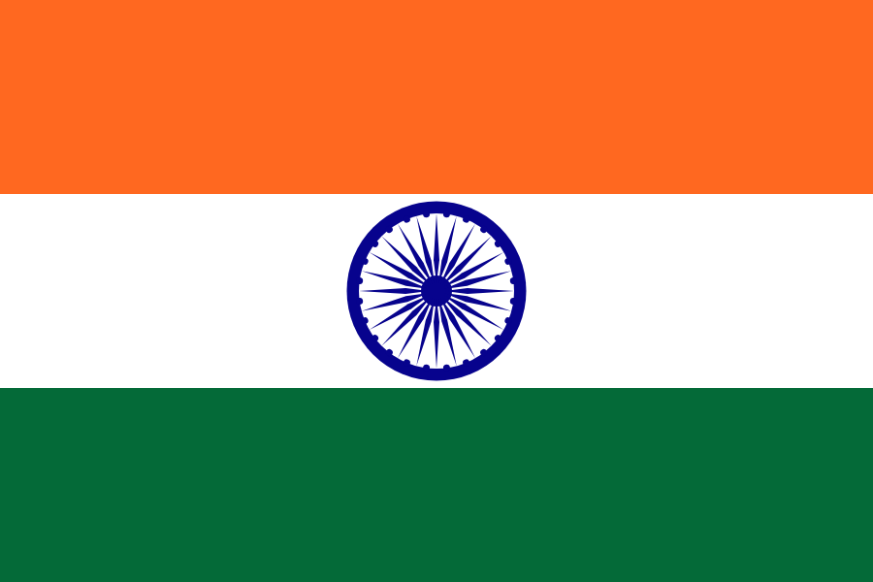
Attitudes towards India
The exact wording of the question:
"What is your attitude towards India: more positive or negative?"

Slide 59
Attitudes towards Pakistan
The exact wording of the question:
"What is your attitude towards Pakistan: more positive or negative?"

Slide 60
Attitude towards Singapore
The exact wording of the question:
"What is your attitude towards Singapore: more positive or negative?"

Slide 61
Attitudes towards Thailand
The exact wording of the question:
"What is your attitude towards Thailand: more positive or negative?"

Slide 62
Attitudes towards Argentina
The exact wording of the question:
"What is your attitude towards Argentina: more positive or negative?"

Slide 63
Attitudes towards Bolivia
The exact wording of the question:
"What is your attitude towards Bolivia: more positive or negative?"

Slide 64
Attitudes towards Brazil
The exact wording of the question:
"What is your attitude towards Brazil: more positive or negative?"

Slide 65
Attitudes towards Venezuela
The exact wording of the question:
"What is your attitude towards Venezuela: more positive or negative?"

Slide 66
Attitudes towards Guyana
The exact wording of the question:
"What is your attitude towards Guyana: more positive or negative?"

Slide 67
Attitudes towards Colombia
The exact wording of the question:
"What is your attitude towards Colombia: more positive or negative?"

Slide 68
Attitude towards Paraguay
The exact wording of the question:
"What is your attitude towards Paraguay: more positive or negative?"

Slide 69
Attitude towards Peru
The exact wording of the question:
"What is your attitude towards Peru: more positive or negative?"

Slide 70
Attitude towards Suriname
The exact wording of the question:
"What is your attitude towards Suriname: more positive or negative?"

Slide 71
Attitude towards Uruguay
The exact wording of the question:
"What is your attitude towards Uruguay: more positive or negative?"

Slide 72
Attitude towards Chile
The exact wording of the question:
"What is your attitude towards Chile: more positive or negative?"

Slide 73
Attitude towards countries (Europe, North America)
What is your attitude towards...: more positive or negative?

Slide 74
Attitudes towards countries (Arab/Muslim countries)
What is your attitude towards...: more positive or negative?

Slide 75
Attitudes towards countries (Central Asia, Caucasus)
What is your attitude towards...: more positive or negative?

Slide 76
Attitude towards countries (South, East Asia, Oceania)
What is your attitude towards...: more positive or negative?

Slide 77
Attitudes towards countries (South America)
What is your attitude towards...: more positive or negative?

Slide 78
Top countries in terms of attitudes of Ukrainians
What is your attitude towards...: more positive or negative?

Slide 79
https://www.youtube.com/@ExpertsClub

